Slide 1
Maven Sales Toy Analysis
Database: MS SQL
Dash boarding tool: Power BI
Prepared By : Pavan

Slide 2
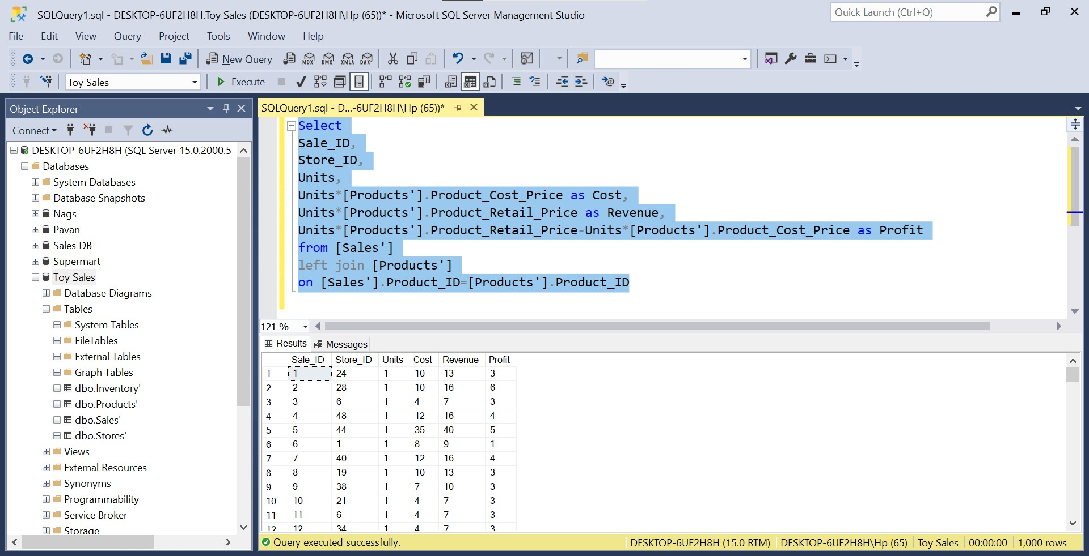
Analysis
2 years of sales data from 2017 to 2018.Deployed in the Microsoft SQL server for cleaning and Analyzing the dataset.

Slide 3




Analysis
Key Observation
The sales transaction for two consecutive years 2017 and 2018 makes up this dataset. About 1 million units were sold within this period, generating a total sale of $14.44 million with a total cost of $10.43 million and a profit of $4.01 million.

Slide 4
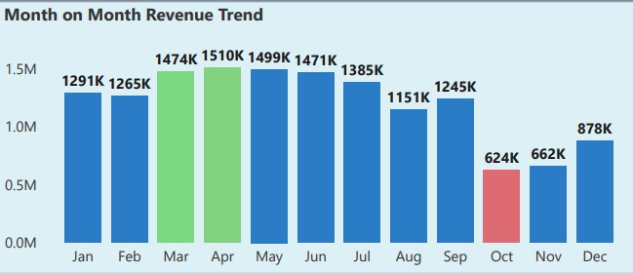
Analysis
Key Observation
April is the month with the highest number of sales with $1.5 million and 112.7K units sold, the month with the lowest sales is October with $623.9K and 47.9K units sold.

Slide 5
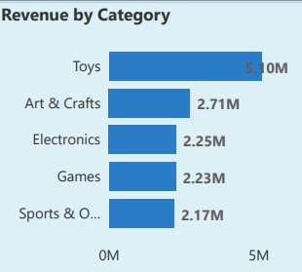
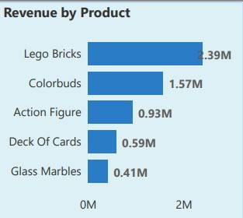
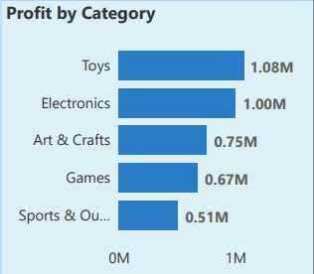
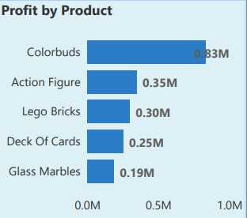
Analysis
Key Observation
Toys product category records the highest sales of $5.1 million from 267.2K units sold. The total cost of this product category is about 78.4% of the total sales. Electronics, Games, Sports & Outdoors product categories all made >$2.15 million in sales.

Slide 6
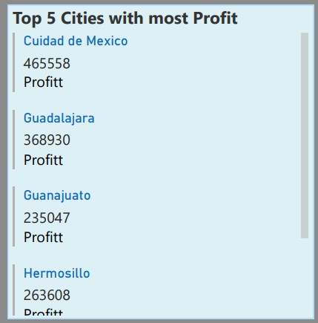
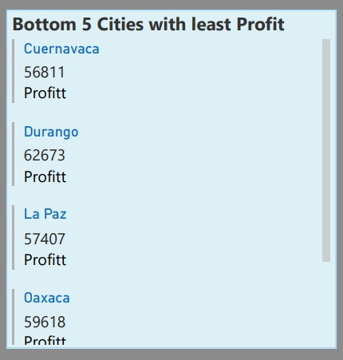
Analysis
Key Observation
In this period Ciudad de Mexico 1 is the store with the highest sales of $465.56K, the total cost of $322.3K and profit of $1111.3K from the sales of 33.5K units. Airport location has the lowest total sales with $1.3 million, contributing 9% to the total sales from 3 stores.

Slide 7
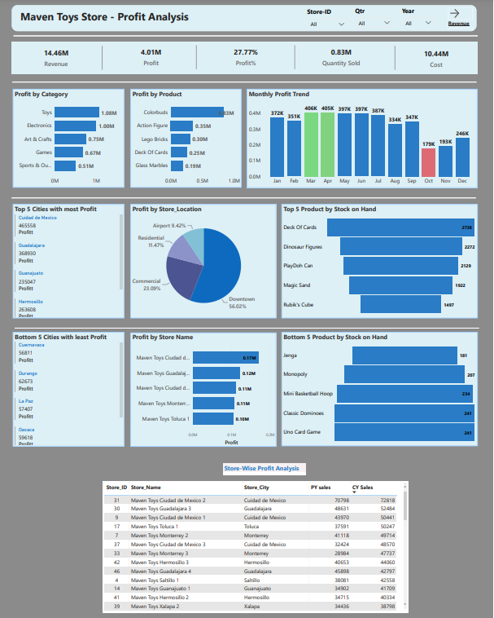
Sales Analysis- Final Dashboard
Recommendations
There was a drastic reduction in sales from October. October and November had the lowest sales with sales rising gradually in December. An investigation should be done to know the reason(s) for the poor sales for the last 3 months of the year.
Toys, Arts & Crafts, Sports & Outdoors have a significant amount of cost associated with sales; cost reduction strategies should be in place for this category. Electronics generated a good amount of profit despite selling the lowest units, awareness should be raised to improve sales.

Slide 8
Thank You

